Slide 1
Linear Regression
Y.LAKSHMI PRASAD
08978784848

Slide 2
What we understand?
We need to understand that not all variables are used to build a model.
Some independent variables are insignificant and add nothing to your understanding of the outcome/ response/ dependent variable.

Slide 3
Variable/Feature Selection
Variable selection is intended to select the “best” subset of predictors
Prior to variable selection:
Identify outliers and influential points - maybe exclude them at least temporarily or treat them.
Add in any transformations of the variables that seem appropriate.

Slide 4
Forward Inclusion
Start with no variables in the model.
For all predictors not in the model, check their p-value if they are added to the model. Choose the one with lowest p-value less than αcrit .
Continue until no new predictors can be added.
In this procedure, the first independent variable entered into the model is the one with the highest correlation with the dependent variable.

Slide 5
CARDIO Sample data

Slide 6
CARDIO Example
Dependent Variable
y = BMI
Independent Variables
x1 = Age in years
x2 = FFNUM, a measure of fast food usage,
x3 = Exercise, an exercise intensity score
x4 = Beers per day

Slide 7
Forward Inclusion

Slide 8
Forward Inclusion

Slide 9
Backward Elimination
1. Start with all the predictors in the model
2. Remove the predictor with highest p-value greater than αcrit
3. Refit the model and go to 2
4. Stop when all p-values are less than αcrit .
The αcrit is sometimes called the “p-to-remove” and does not have to be 5%. If prediction performance is the goal, then a 15-20% cut-off may work best.

Slide 10
Backward Elimination
Global hypothesis
b₀
b₁
b₂
b₃
b₄

Slide 13
Stepwise Regression
It is a combination of backward elimination and forward selection.
This addresses the situation where variables are added or removed early in the process and we want to change our mind about them later
At each stage a variable may be added or removed and there are several variations on exactly how this is done

Slide 14
Drawbacks of Stepwise Regression
Due to the “one-at-a-time” nature of adding/dropping variables, it’s possible to miss the “optimal” model.
The p-values used should not be treated too literally. The removal of less significant predictors tends to increase the significance of the remaining predictors.
Variables that are dropped can still be correlated with the response. It would be wrong to say these variables are unrelated to the response.
Stepwise variable selection tends to pick models that are smaller than desirable for prediction purposes

Slide 15
Variable selection (RFE)
Recursive feature elimination is based on the idea of repeatedly constructing a model and then choosing either the best or the worst performing feature, setting that feature aside and then repeating the process with the rest of the features.
This process is applied until all the features in the dataset are exhausted.
Features are then ranked according to what they were eliminated.
As such, it is a greedy optimization for finding the best performing subset of features

Slide 16
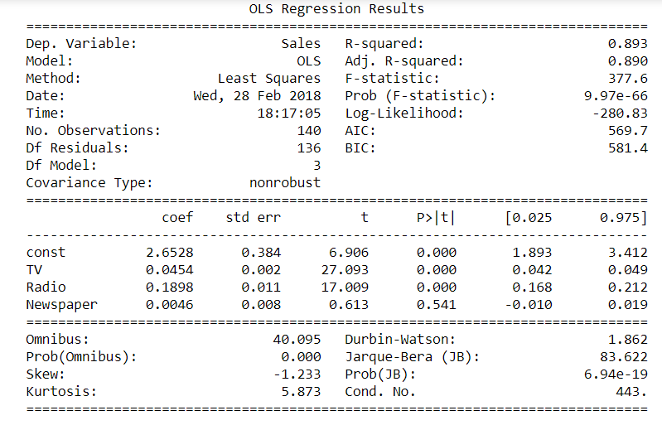
Understanding the Regression output

Slide 17
p-value
p-value is used for hypothesis testing.
Here, in regression model building, the null hypothesis corresponding to each p-value is that the corresponding independent variable does not impact the dependent variable.
The alternate hypothesis is that the corresponding independent variable impacts the response.
Now, p-value indicates the probability that the null hypothesis is true.
Therefore, a low p-value, i.e. less than 0.05, indicates that you can reject the null hypothesis.

Slide 18
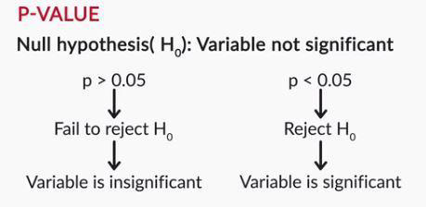
P-Value

Slide 19
Cross Validation

Slide 20
Cross Validation
Before assessing the relative importance of the predictors or drawing any other inferences, it is necessary to cross-validate the regression model.
Cross-validation examines whether the regression model continues to hold on comparable data not used in the estimation.

Slide 21
Cross-Validation Procedure
The available data are split into two parts, the estimation (Training) sample and the Validation sample.
The estimation (Training) sample generally contains 50 – 90% of the total sample.
The regression model is estimated using the data from the estimation sample only. This model is compared with the model estimated on the entire sample to determine the agreement in terms of the signs and magnitudes of the partial regression coefficients.

Slide 22
Cross-Validation Procedure
4. The estimated model is applied to the data in the validation sample to predict the values of the dependent variable,Yi,for the observations in the validation sample.
5. The observed values (Yi), and the predicted values, (Y ^ i), in the validation sample are correlated to determine the simple R2.
This measure, r2, is compared with R2 for the total sample and with R2 for the estimation sample to assess the degree of shrinkage.

Slide 23
Drawbacks of Hold out method
The holdout method has two basic drawbacks:
1. In problems where we have a sparse dataset we may not be able to afford the “luxury” of setting aside a portion of the dataset for testing.
2. Since it is a single train-and-test experiment, the holdout estimate of error rate will be misleading if we happen to get an “unfortunate” split.

Slide 24
Cross Validation Methods
The limitations of the holdout can be overcome with a family of re-sampling methods at the expense of higher computational cost.
Cross Validation
Random Sub-sampling
K-Fold Cross-Validation
Leave-one-out Cross-Validation
Bootstrap

Slide 25
Random Sub-sampling
Random Sub-sampling performs K data splits of the entire dataset n Each data split randomly selects a (fixed) number of examples without replacement
For each data split we retrain the classifier from scratch with the training examples and then estimate Ei with the test examples.

Slide 26
K-Fold Cross Validation
It is a sampling Technique used primarily for small data sets, where data is too small to partition into training and testing subsets.
Main advantage is all of the data is used in building models, so all the patterns represented in the training data is used in building the models.
K refers to how many subsets are used for the modeling

Slide 27
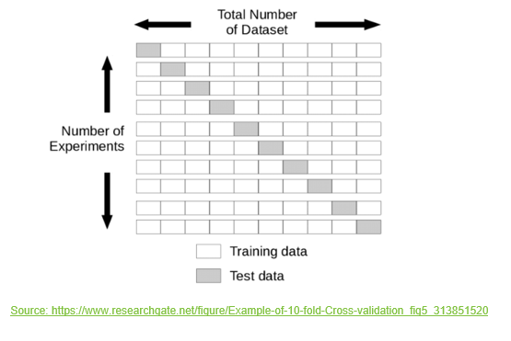
Procedure for K-fold cross validation
Create k distinct data subsets through random sampling
Assign a role to each subset. k-1 will be used for training, 1 for testing. Begin by assigning subset 1 to testing and subsets 2 through k for training.
Rotate roles so each subset is used for testing one time and training k-1 times.

Slide 28
K-Fold Cross Validation
A model is built from each of the folds – total of k models
Any number of folds can be used.
The hold-out subset is used to test the model, and the errors are averaged over the subsets.
If the accuracy is similar for all folds, the modeling procedure is viewed as being stable and not over-fit.

Slide 29
Leave-one-out Cross Validation
Leave-one-out is the degenerate case of K-Fold Cross Validation, where K is chosen as the total number of examples
For a dataset with N examples, perform N experiments
For each experiment use N-1 examples for training and the remaining example for testing

Slide 30
How many folds are needed?
With a large number of folds
+ The bias of the true error rate estimator will be small (the estimator will be very accurate)
- The variance of the true error rate estimator will be large
- The computational time will be very large as well (many experiments)
With a small number of folds
+ The number of experiments and, therefore, computation time are reduced
+ The variance of the estimator will be small
- The bias of the estimator will be large (conservative or smaller than the true error rate)

Slide 31
The bootstrap
The bootstrap is a re-sampling technique with replacement.
From a dataset with N examples:
Randomly select (with replacement) N examples and use this set for training
The remaining examples that were not selected for training are used for testing
This value is likely to change from fold to fold
Repeat this process for a specified number of folds (K)
As before, the true error is estimated as the average error rate on test examples

Slide 32
Questions?

